Slide 1
Client-Server Architecture
Author: Steven Villarosa

Slide 2
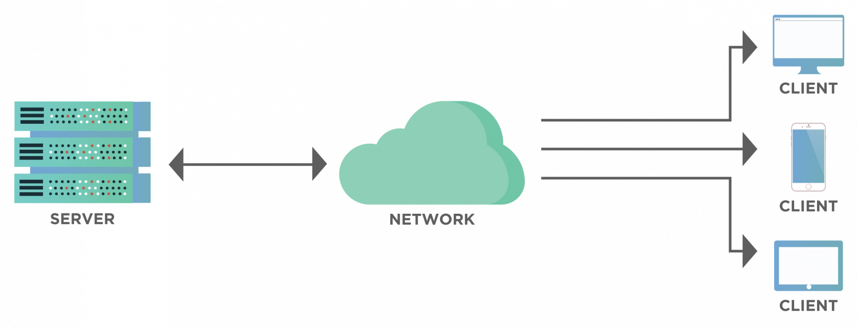
What is Client Server Architecture?
A client(consumer) is a device or a program that requests service/data to the server
A server(producer) is a system or a computer program that provides service/data
All users/devices are connected to a server
All users/devices communicate throught a centralized servers instead of communicating with each other.

Slide 3
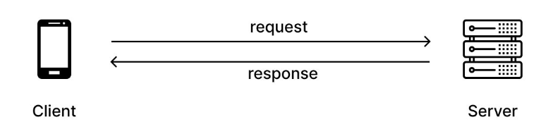
HTTP (Hypertext Transfer Protocol)
is a protocol used for exchanging information over the internet.
The client(browser) is always the initiating entity by sending HTTP request.
Communication in HTTP centers around a concept called the request-response cycle.
Request-Response Cycle
The client initiates a request to the server by sending an HTTP request message.
The server receives the request message and processes it.
The server sends the response message back to the client.
The client receives the response message and processes it.

Slide 4
HTTP Request
An HTTP requests consist of the following elements:
GET /watch?v=8PoQpnlBXD0 HTTP/1.1
Host: www.youtube.com
Accept-Language: En
"GET" is HTTP method; it defines the operation the client wants to perform.
"/watch?v=8PoQpnlBXD0" is the path of the resource to fetch.
"HTTP/1.1" is the version of the HTTP protocol.
The second line specifies the host of the website, which is www.youtube.com.
The third line contains optional header that convey additional information for the servers.

Slide 5
HTTP Methods
The most commonly used HTTP request methods are:
GET
to read/retrieve data from a web server.
POST
sends data to the server for processing.
PUT
to modify the data on the server.
replaces the entire content if it already exist.
it will generate one if is not existing.
PATCH
similar to PUT but it modifies a part of the data.
DELETE
to delete the data on the server at a specified location.

Slide 6
HTTP Response
The first line contains:
HTTP protocol
A status code
A status message
The following lines are the response headers providing data to the client.
After the space is the response body. When we visit a web page, the response is usually an HTML string which the browser builds. However, in this case, the response is a JSON string.
Below is a sample HTTP response.
HTTP/1.1 200 OK
Date: Sun, 28 Mar 2023 10:15:00 GMT
Content-Type: application/json
Content-Length: 1024
{
"name": "John Doe",
"email": "johndoe@example.com",
"age": 30
}

Slide 7
URL - Uniform Resource Locator
URL Encoding (Percent Encoding)
Web browsers request pages from web servers by using a URL.
The URL is the address of a web page, like: https://www.google.com.
Converts characters into a format that can be transmitted over the Internet.
URLs can only be sent over the Internet using the ASCII character-set.
Since URLs often contain characters outside the ASCII set, the URL has to be converted into a valid ASCII format.
URL encoding replaces unsafe ASCII characters with a "%" followed by two hexadecimal digits.
URL encoding replaces a space with a plus (+) sign or with %20.

Slide 8
What is a Query String?
Is a set of characters added to the end of a URL.
Use to pass information to the web server
It begins after the question mark (?) and can include one or more parameters.
A query string can be made up of multiple set. We call each set a query paramater.
Each query parameter is a key-value pair separated by equal sign(=).
An ampersand (&) separates multiple parameters.
http://localhost/get_request/get_grade.php?subject=comp20163
URL
? Separates URL and query parameters
Query String
An ampersand (&) separates multiple parameters.
http://localhost/get_request/get_grade.php?subject=comp20163&title=Web+Development
Parameter 1
Parameter 2

Slide 9
PHP Variables
Like Javascript, PHP is also dynamically and weakly typed language.
Dynamic - Data type of a variable changes during runtime
Weak - Data type of a variable is not checked during compilation
Rules for declaring PHP variable:
A variable must start with a dollar ($) sign, followed by the variable name.
It can only contain alpha-numeric character and underscore (A-z, 0-9, _).
A variable name must start with a letter or underscore (_) character.
A PHP variable name cannot contain spaces.
Variable name cannot start with a number or special symbols.
PHP variables are case-sensitive, so $name and $NAME both are treated as different variable.

Slide 10
PHP Variables
htdocs/interpolation.php
In PHP, both single and double quotes are used to create strings.
However, only double quotes can interpolate string.
To interpolate strings, simply embed the variable into a double quoted string prefixed with $.
To concatenate strings, use dot(.).
<?php
$name = "John Doe";
echo "Welcome $name!";
?>
htdocs/concatenation.php
<?php
$name = "John Doe";
echo "Welcome ".name;
?>

Slide 11
PHP $_GET
PHP $_GET is a PHP super global variable to access data received from query string.
htdocs/get_query_param.php
<?php
$subject = $_GET['subject'];
echo "Welcome to $subject!";
?>
When you navigate to "localhost/get_query_param.php" script without the query params, it will throw an error because the $_GET array does not have a key 'subject'.
To make this code work, we have to check whether the value is empty.

Slide 12
PHP isset() Function
Check whether a variable is empty or whether the variable is set/declared
$a = 0;
// True because $a is set
if (isset($a)) {
echo "Variable 'a' is set";
}
$b = null;
// False because $b is NULL
if (isset($b)) {
echo "Variable 'b' is set.";
}
Let's revise the previous code so it will not return error with or without a query param.
htdocs/get_query_param.php
<?php
if(isset($_GET['subject'])) {
$subject = $_GET['subject'];
echo "Welcome to $subject!";
}
echo "Please provide subject code.";
?>

Slide 13
Passing Data from HTML Form
HTML form has attributes to configure the way how data is passed to the server.
action - where the data will be passed
method - how the data will be passed
htdocs/index.html
htdocs/get_query_param.php
<h1>Passing Data from HTML Form</h1>
<form action="./get_query_param.php"
method="get">
<label>Enter Subject: </label>
<input name="subject">
<button type="submit">
Submit
</button>
</form>
<?php
if(isset($_GET['subject'])) {
$subject = $_GET['subject'];
echo "Welcome to $subject!";
}
echo "Please provide subject code.";
?>
Note that we don't need the javascript when passing data through HTML form

Slide 14
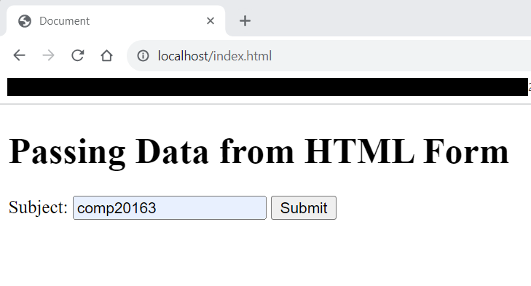
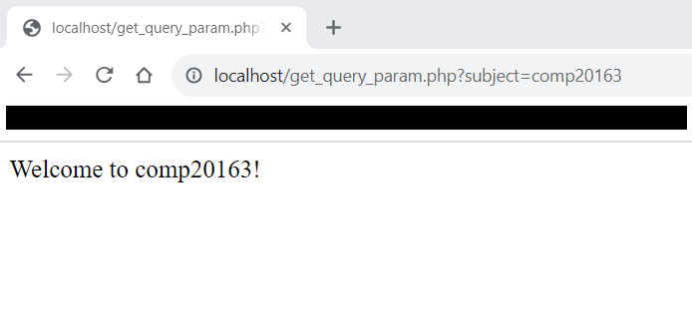
Passing Data from HTML Form
When you set a forms action to a PHP script, all the data from the form will be passed into the PHP script when the user submits the form.
When you set the form method to get, the form data will become a query string and each field are query parameters.
The name attribute of the form field will will become the key in the query param and the field value will become the value in the query param.
When you submit the form, notice that your location also changed.
Change the method to post and see the difference.

Slide 15
Building the page from the web server
htdocs/get_query_param.php
Update the PHP file so it will look like this.
In this example, we are building the web page from the server through PHP.
<html>
<head>
<title>Welcome</title>
</head>
<body>
<?php
$grade = 1.25;
if(isset($_GET['subject'])) {
$subject = $_GET['subject'];
echo "<h1>Welcome to $subject!</h1>
<h2>Your grade is $grade</h2>";
return;
}
echo "<strong>Please provide subject code.<strong>";
?>
</body>
</html>

Slide 16
$_SERVER['REQUEST_METHOD']
returns the request method used to access the page.
it can be use to respond differenty to every method.
htdocs/request_method.php
<?php
switch($_SERVER['REQUEST_METHOD']) {
case 'POST':
echo "That is a 'POST' request.";
return;
case 'GET':
echo "That is a 'GET' request.";
return;
default:
echo "That's a request.";
break;
}
?>

Slide 17



Static Pages
When you go navigate your browser to a URL, you are sending an HTTP get request to that server. By default, it has no query string.
For static web site such as Netlify and GitHub pages, you are just downloading the HTML file from the server.
GET request to netlify.com
Response
Client
Server

Slide 18




Dynamic Pages
For dynamic website, the pages are built by using server side programming such as PHP.
Only HTML, CSS, and JS are passed to the client. Server side scripts and programming languages are exclusively placed on the server and the client has no idea about it.
GET request to google.com/search?q=hello
Response
Client
Server
HTMLS, CSS, and JS are called frontend because they were interacting directly with the client. These are the things that are visible to the user. PHP, databases, & other server side technologies we refer to as backend because they are not visible to the user.

Slide 19
10 MIN BREAK
Now is your chance to fully understand what was discussed. Practice the code, ask your classmates, and discuss among yourselves. You may also go to the restroom but make sure it won't last more than 10 mins.

Slide 20
Getting dynamic data with AJAX - HMTL
In this HTML file we have an input element with id "sid". Since you are request data through ajax, you don't need the name attribute. You only need to get the value of the input.
We have a button with text "Get Grades" that will run our JS codes by calling getData() function.
We also have a div with class result. This is where we place the result of our AJAX request.
htdocs/index.html
<body>
<h1>Getting Dynamic data with AJAX</h1>
<label for="student_id">Student ID:</label>
<input id="sid">
<button type="button" onclick="getData()">
Get Grades
</button>
<div class="result"></div>
<script src="script.js"></script>
</body>

Slide 21
Getting dynamic data with AJAX - JS
htdocs/script.js
function getData() {
const studentId = document.querySelector("#sid").value;
const httpRequest = new XMLHttpRequest();
httpRequest.open('GET', `./grades.php?student_id=${studentId}`);
httpRequest.onload = () => {
document.querySelector(".result").innerHTML = httpRequest.responseText;
};
httpRequest.send('');
}
In this JS file, we first get the value of our input and store it to variable studentId.
Then, we configure our AJAX request to "get" method and with a query param student_id and its value will be coming from our studentId variable.
When the AJAX request finishes, it will change the contents our div with class "result".

Slide 22
Getting dynamic data with AJAX - PHP
In our PHP file, we created a variable $studentID to contain the value passed from the GET request.
We then print a JSON string depending on the value of the $studentID.
grades.php
<?php
$studentID = $_GET["student_id"];
switch($studentID) {
case "1":
echo '{"grade": 85, "remarks": "Passed"}';
return;
case "2":
echo '{"grade": 74, "remarks": "Failed"}';
return;
case "3":
echo '{"grade": 95, "remarks": "Passed"}';
return;
};
?>

Slide 23
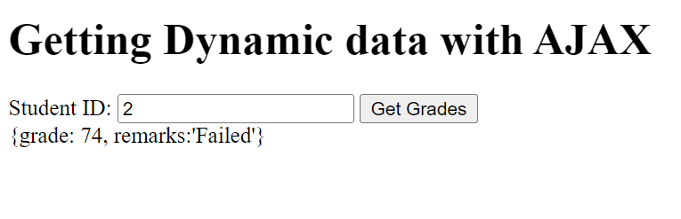
Getting dynamic data with AJAX - Result
Below image will be the result when you enter a student ID and clicked the "Get Grades" button.
However, the page is not intuitive. Even if we format the results properly, the information provided is lacking to make a complete thought. We don't know any other details of the student except of the student's ID.

Slide 24
Multiple AJAX Request Using Callbacks
Add another PHP file in your htdocs folder.
students.php
<?php
$studentID = $_GET['student_id'];
switch($studentID) {
case '1':
echo '{"first_name": "John", "last_name": "Doe"}';
return;
case '2':
echo '{"first_name": "Jane", "last_name": "Dee"}';
return;
case '3':
echo '{"first_name": "Peter", "last_name":"Sy"}';
return;
};
?>

Slide 25
Multiple AJAX Request Using Callbacks
Update your JS file.
script.js
function getData() {
const studentId = document.querySelector("#sid").value;
const httpRequest = new XMLHttpRequest();
httpRequest.open('GET', `./grades.php?student_id=${studentId}`);
httpRequest.onload = () => {
const httpRequest2 = new XMLHttpRequest();
httpRequest2.open('GET', `./students.php?student_id=${studentId}`);
httpRequest2.onload = () => {
document.querySelector(".result").innerHTML
= `${httpRequest.responseText}, ${httpRequest2.responseText}`;
}
httpRequest2.send();
};
httpRequest.send('');
}

Slide 26
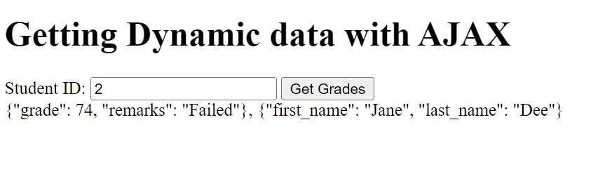
Getting dynamic data with AJAX
In the image below, we now have the grades and the student last name and first name.
Do you think the data is now complete?
We still don't have the subject details.
If we make another callback, we might encounter what we call a callback hell.

Slide 27
Callback Hell
script.js
Callback Hell is essentially nested callbacks stacked below one another forming a pyramid structure. Every callback depends/waits for the previous callback, thereby making a pyramid structure that affects the readability and maintainability of the code.
function getData() {
…
httpRequest.onload = () => {
…
httpRequest2.onload = () => {
…
httpRequest3.onload = () => {
…
httpRequest4.onload = () => {
…
}
}
httpRequest3.send();
}
httpRequest2.send();
};
httpRequest.send('');
}

Slide 28
Fetch
The Fetch API interface allows web browser to make AJAX requests to web servers.
Unlike XMLHttpRequest, fetch is not callback-based but a promise-based operation.
Then fetch() method sends the http request to server.
The then() method is invoked when the response is received.
In this code we fetch request from the grades.php supplied with the correct query string.
After that, we transform the response to json object.
Finally we print the response data in the console.
script.js
function getData() {
const studentId = document.querySelector("#sid").value;
fetch(`./grades.php?student_id=${studentId}`)
.then((response) => response.json())
.then(jsonObj => {
console.log(jsonObj);
});
}
To create series of HTTP request, you can use chaining just like what we did with arrays.

Slide 29
Chaining Fetch
script.js
function getData() {
const studentId = document.querySelector("#sid").value;
const studentGradeObj = {};
fetch(`./grades.php?student_id=${studentId}`)
.then((response) => response.json()).then(gradeOjb => {
studentGradeObj.grade = gradeOjb.grade;
studentGradeObj.remarks = gradeOjb.remarks;
return fetch(`./students.php?student_id=${studentId}`);
}).then((response) => response.json()).then(studentObj => {
studentGradeObj.first_name = studentObj.first_name;
studentGradeObj.last_name = studentObj.last_name;
document.querySelector(".result").innerHTML= `<h3>Student Grades</h3>
First Name: ${studentGradeObj.first_name}<br>
Last Name: ${studentGradeObj.last_name}<br>
Grade: ${studentGradeObj.grade}<br>
Remarks: ${studentGradeObj.remarks}<br>`;
});
}
In the then method, we return another fetch which is a request to another endpoint(students.php).
The following then will refer to the response for the request we made to students.php.

Slide 30
Now that you understood the concept of callback hell,
from now on, we will use Fech instead of XMLHttpRequest.

Slide 31
Dynamic Pages with AJAX
On the first load, the server will build the HTML, CSS, and JS in the server and pass it in the client.
Succeeding HTTP request will be done through JS.
The server will no longer build the HTML files but just the needed data in the form of JSON.
GET request to google.com/search?q=hello
GET request thu fetch
Response
Response JSON {...}
Server
Client

Slide 32
Dynamic Pages with AJAX
htdocs/index.php
htdocs/index.php
…
<body>
<h1>Dynamic Pages with AJAX</h1>
<p>
<?php
$studentID = $_GET['student_id'];
switch($studentID) {
case '1':
echo 'Welcome John Doe!';
break;
case '2':
echo 'Welcome Jane Dee!';
break;
//continuation at the right side
case '3':
echo 'Welcome Peter Sy!';
break;
};
?>
</p>
<button type="button" onclick="getData(<?php echo $studentID ?>)">
Get Grades
</button>
<div class="result"></div>
<script src="script.js"></script>
</body>

Slide 33
Dynamic Pages with AJAX
htdocs/script.js
function getData(studentId) {
const httpRequest = new XMLHttpRequest();
httpRequest.open('GET', `./grades.php?student_id=${studentId}`);
httpRequest.onload = () => {
document.querySelector(".result").innerHTML = httpRequest.responseText;
};
httpRequest.send('');
}

Slide 34
Dynamic Pages with AJAX
htdocs/grades.php
<?php
$studentID = $_GET["student_id"];
switch($studentID) {
case "1":
echo '{"grade": 85, "remarks": "Passed"}';
return;
case "2":
echo '{"grade": 74, "remarks": "Failed"}';
return;
case "3":
echo '{"grade": 95, "remarks": "Passed"}';
return;
};
?>

Slide 35
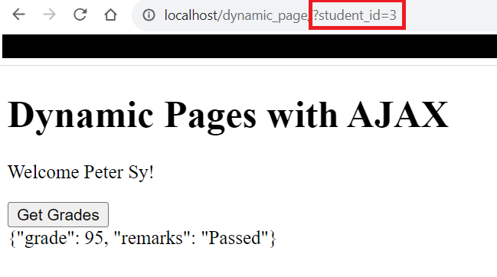
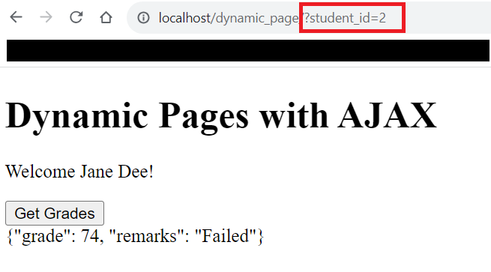
Dynamic Pages with AJAX
When the page loads, it stores the value of the query parameter into a variable $studentID.
Based on the value of the $studentID, it will display the corresponding welcome text.
When the "Get Grades" button is clicked, $studentID will be passed to getData() function in JS as an argument.

Slide 36
BREAK
Prepare for your next exercise. Practice the code, ask your classmates, and discuss among yourselves. You may also go to the restroom but make sure it won't last more than 10 mins.

Slide 37
Reminder
Exercise 14(Deadline June 4, 2024, 11:59PM)
Prepare your Project Timeline and upload it into the "document" folder.(Deadline June 7, 2024)

Slide 38
References:
https://www.toolsqa.com/client-server/client-server-architecture-and-model
https://www.freecodecamp.org/news/what-is-http/
https://www.javatpoint.com/php-variables
https://www.w3schools.com/tags/ref_urlencode.ASP
https://www.claravine.com/a-query-on-using-query-strings-parameters/
https://www.geeksforgeeks.org/what-to-understand-callback-and-callback-hell-in-javascript/

